Slide 1
Swoop Performance Analysis
Revenue • Customers • Operations
Business Intelligence & Data Analytics Project
Prepared By: ILEN LOVETH

Slide 2
PROJECT OVERVIEW
About Swoop
Swoop is a food delivery platform that allows customers to order meals from multiple restaurants within a single transaction. Operating across San Francisco, Los Angeles, and New York, the company combines convenience with sustainability through its electric scooter delivery network and bulk meal ordering feature.
As the business expanded, large volumes of data were generated across customers, orders, deliveries, restaurants, and promotions. However, management lacked a centralised reporting system capable of turning this data into actionable business insights.
Project Goal
The goal of this project was to analyse Swoop's operational data and develop an interactive dashboard that provides visibility into revenue performance, customer behaviour, and operational efficiency.
Tools & Methodology
Tools Used
PostgreSQL
SQL
Power BI
DAX
Approach
Data Cleaning & Validation
Data Modelling
Revenue Analysis
Customer Segmentation (RFM)
Cohort Retention Analysis
Dashboard Development

Slide 3
BUSINESS PROBLEM
Despite its rapid growth, Swoop faces several challenges that limit its ability to make data-driven decisions.
Key Challenges
Revenue performance is difficult to monitor across products, customers, and order types.
High-value customers are not clearly identified, limiting customer retention efforts.
Delivery and operational costs continue to increase without detailed performance visibility.
Customer retention trends are not actively monitored.
Decision-makers lack access to a real-time reporting environment.
Why This Matters
Without reliable business intelligence, management may struggle to identify growth opportunities, improve profitability, and optimise operational performance.

Slide 4
Project Objectives
This project focused on four key objectives:
Revenue Analysis
Analyse revenue performance across customers, orders, and meal categories.
Identify revenue drivers and profitable products.
Monitor revenue trends over time.
Customer Analysis
Identify high-value customers.
Segment customers using RFM analysis.
Evaluate customer retention behaviour through cohort analysis.
Operational Analysis
Analyse delivery costs.
Measure courier performance.
Compare profitability between Bulk and Standard orders.
Dashboard Development
Create interactive dashboards.
Monitor KPIs in real time.
Support faster and more informed business decisions.

Slide 5
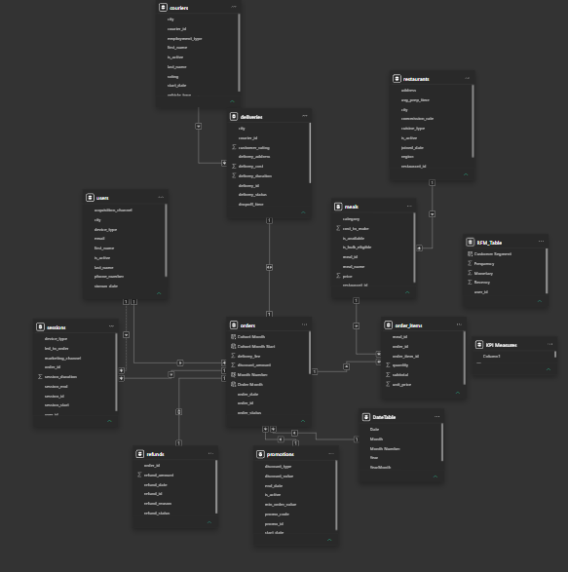
DATA MODEL & ANALYTICAL APPROACH
The analysis was built using data from multiple business entities, including Users, Orders, Order Items, Deliveries, Couriers, Restaurants, Promotions, Refunds, and Sessions.
To ensure accurate reporting, the following steps were completed:
Data validation and quality checks
Relationship creation between business tables
Development of calculated measures using DAX
Revenue and profitability analysis
Customer segmentation and retention analysis
Dashboard design and visualisation
Key KPIs Developed
Total Revenue
Total Profit
Total Orders
Total Customers
Average Order Value
Profit Margin %
Average Delivery Cost
Customer Retention Metrics

Slide 6
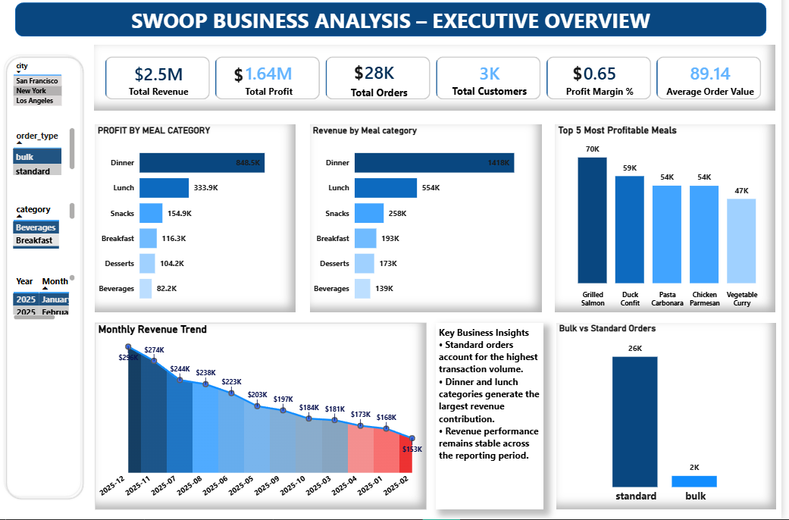
EXECUTIVE OVERVIEW DASHBOARD
This dashboard provides management with a high-level summary of revenue, profitability, customer activity, and business performance.
Key Findings
Revenue remained relatively stable throughout the reporting period, indicating consistent customer demand.
Lunch and Dinner categories generated the highest revenue contribution, highlighting peak meal consumption patterns.
Standard orders represented the largest share of transaction volume across the platform.
Bulk orders generated higher profit despite lower order volume, demonstrating stronger profitability per transaction.
Profitability varies across meal categories, showing the importance of analysing both revenue and profit.
Business Impact
Strong revenue performance supports continued business growth.
Bulk ordering presents an opportunity to improve margins.
High-performing meal categories can be leveraged to drive future revenue growth.
Recommendations
Promote high-margin meal categories through targeted marketing campaigns.
Encourage bulk orders through discounts and bundle offers.
Continue monitoring revenue trends to identify seasonal opportunities.

Slide 7
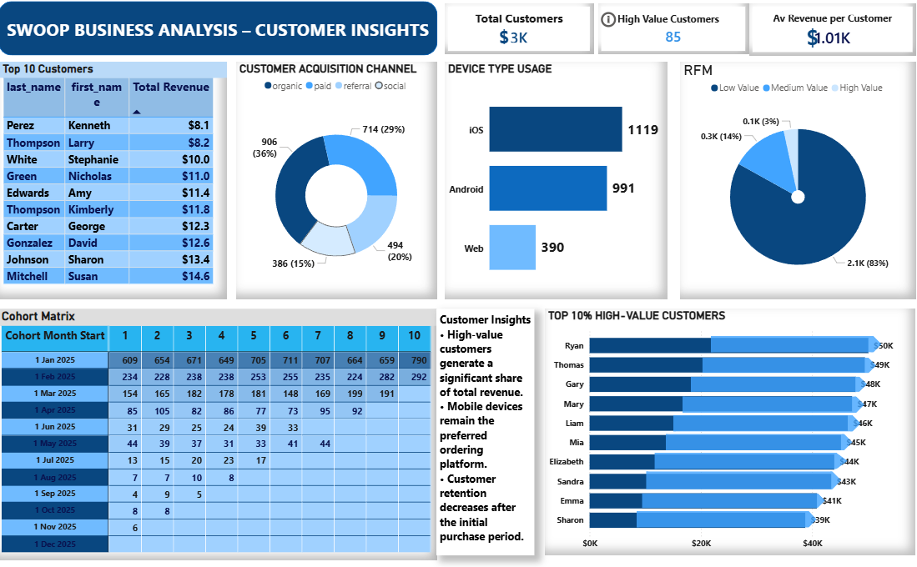
CUSTOMER INSIGHTS DASHBOARD
Customer Analysis
The Customer Insights dashboard focuses on customer acquisition, spending behaviour, segmentation, and retention.
Key Findings
A relatively small group of customers contributes a significant share of total revenue.
Mobile devices remain the most frequently used ordering platform.
Customer acquisition channels perform differently, indicating opportunities for marketing optimisation.
RFM analysis identified distinct customer value segments ranging from high-value to low-value customers.
Cohort analysis revealed a gradual decline in customer retention after acquisition.
Business Impact
Retaining high-value customers has a direct impact on revenue performance.
Marketing investment can be optimized by focusing on high-performing acquisition channels.
Customer retention represents a major opportunity for long-term growth.
Recommendations
Introduce loyalty and rewards programmes for high-value customers.
Develop personalised marketing campaigns based on customer segments.
Re-engage inactive customers through targeted promotions.
Focus acquisition efforts on channels delivering higher customer quality.

Slide 8
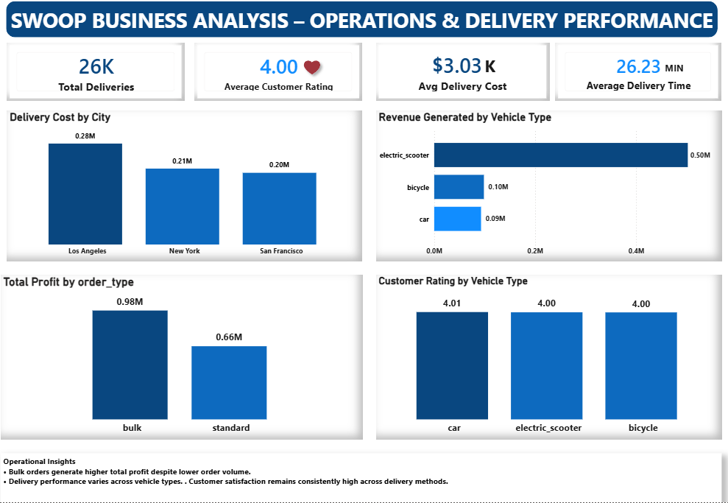
OPERATIONS & DELIVERY DASHBOARD
Operational Performance Analysis
This dashboard evaluates delivery operations, courier performance, customer satisfaction, and order profitability.
Key Findings
Delivery costs vary slightly across operating cities.
Customer ratings remain consistently high across delivery methods.
Vehicle type influences operational output and delivery activity.
Bulk orders continue to generate stronger profit performance compared to standard orders.
Delivery operations remain efficient while maintaining positive customer experiences.
Business Impact
Delivery costs directly influence overall profitability.
Customer satisfaction contributes to retention and brand reputation.
Efficient courier allocation improves operational effectiveness.
Recommendations
Monitor delivery costs regularly to identify optimisation opportunities.
Allocate resources towards high-performing delivery methods.
Maintain service quality standards through continuous performance monitoring.
Increase promotion of profitable order types.

Slide 9
BUSINESS IMPACT & STRATEGIC RECOMMENDATIONS
Business Impact
The dashboard provides management with a single source of truth for monitoring business performance.
Revenue Growth
Improved visibility into revenue drivers and profitable categories.
Better understanding of customer spending patterns.
Enhanced ability to identify growth opportunities.
Customer Retention
Improved identification of high-value customers.
Better targeting of retention and engagement campaigns.
Increased visibility into customer retention trends.
Operational Efficiency
Greater transparency into delivery costs and courier performance.
Improved monitoring of operational performance.
Better allocation of resources across cities and delivery methods.
Decision-Making
Faster access to business-critical KPIs.
Reduced reliance on manual reporting.
Improved confidence in strategic decisions.

Slide 10
CONCLUSION
Conclusion
This project successfully transformed Swoop's operational data into a comprehensive business intelligence solution using PostgreSQL and Power BI.
Through revenue analysis, customer segmentation, cohort retention analysis, and operational performance monitoring, the project provided valuable insights into the factors driving business performance.
The dashboards enable management to monitor key metrics, identify growth opportunities, improve customer retention, optimise operational efficiency, and make more informed business decisions.
Final Takeaway
By turning raw operational data into actionable insights, Swoop is better positioned to improve profitability, strengthen customer relationships, and support future business growth.

Slide 11
Thank You

